Slide 1



Machine Learning
Internal
Sundeep Gullapudi, August 16, 2017

Slide 2
Agenda
Classification
Decision Trees / Random Forest
Support Vector Machines
Demo + Hands On using Scikit Learn
Comparison chart - Algorithms
Un Supervised Learning
K Nearest Neighbors
Demo + Hands On using Scikit Learn
Queries ?

Slide 3
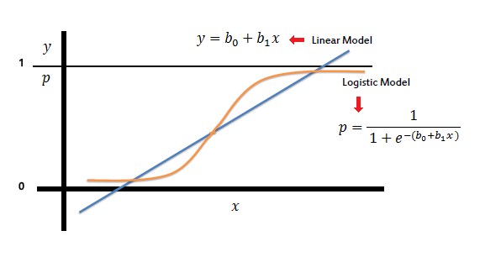

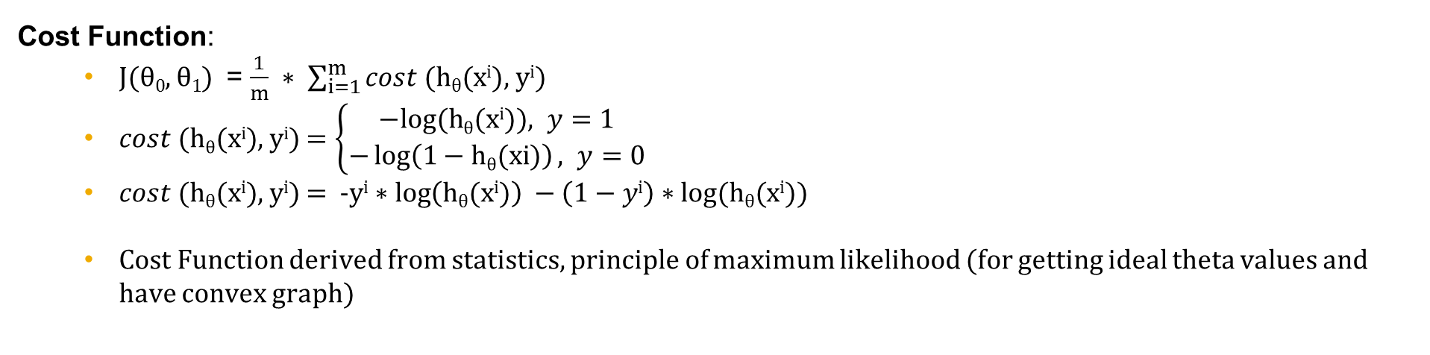
Decision Trees
Intuition:
y = h$θ$(x) = g$θ$(z)
g$θ$(z) = $1/{(1+e−z)}$
z = $θTX$
Decision Boundary:
p(y=1/x; $θ$) ; h$θ$(x) $≥$ 0.5 ; z $≥$ 0
p(y=0/x; $θ$) ; h$θ$(x) $≤$ 0.5 ; z $≤$ 0
Cost Function:
J($θ0$, $θ1$) = $\frac{1}{m} ∗ \sum_{i=1}^{m}{cost (\text{h}θ\text{(}\text{xi}\text{), }\text{yi})}$
$cost (\text{h}θ\text{(}\text{xi}\text{), }\text{yi})$ $=\left\{\begin{aligned}−&log⁡(\text{h}θ\text{(}\text{xi}\text{)}), y=1 \\ −\log\left(1−\text{h}θ\text{(}\text{xi}\text{)}\right), y=0\end{aligned}\right.$
$cost (\text{h}θ\text{(}\text{xi}\text{), }\text{yi})$ = -y$\text{i}∗\log\left(\text{h}θ\text{(}\text{xi}\text{)}\right) −\left(1−y\text{i}\right)∗log⁡(\text{h}θ\text{(}\text{xi}\text{)})$
Cost Function derived from statistics, principle of maximum likelihood (for getting ideal theta values and have convex graph)

Slide 4
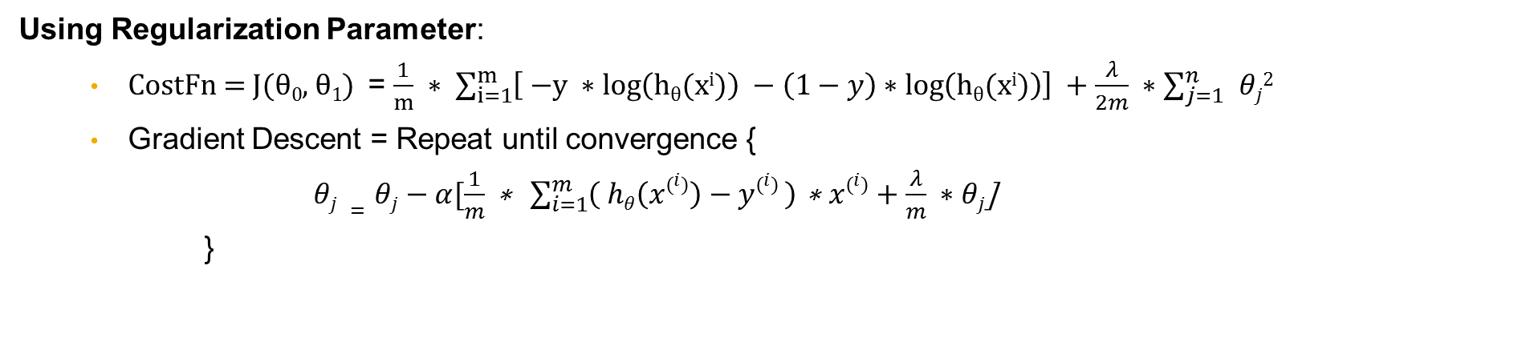
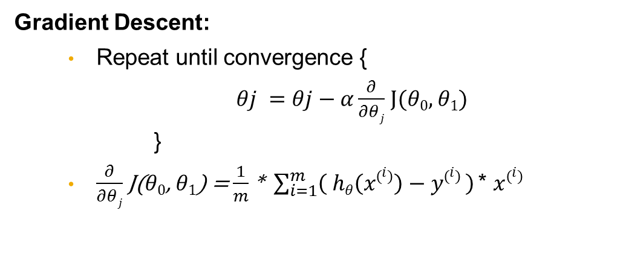
Random Forest
Gradient Descent:
Repeat until convergence {
$θj =θj−α\frac{∂}{∂θj}$ J($θ0$, $θ1$)
}
$\frac{∂}{∂θj}$ J($θ0$, $θ1$) = $\frac{1}{m}$ * $\sum_{i=1}^{m}{\left( hθ\left(x\left(i\right)\right)−y\left(i\right) \right) }$* $x\left(i\right)$
Using Regularization Parameter:
CostFn = J($θ0$, $θ1$) = $\frac{1}{m} ∗ \sum_{i=1}^{m}{\left[ \text{−}\text{y} ∗\log\left(\text{h}θ\text{(}\text{xi}\text{)}\right) −\left(1−y\right)∗\log\left(\text{h}θ\text{(}\text{xi}\text{)}\right)\right] +\frac{λ}{2m} ∗\sum_{j=1}^{n}{ }θj2}$
Gradient Descent = Repeat until convergence {
$θj =θj−α[\frac{1}{m}\text{ ∗ }\sum_{i=1}^{m}{\left( hθ\left(x\left(i\right)\right)−y\left(i\right) \right) }\text{∗ }x\left(i\right)+\frac{λ}{m} ∗θj$]
}

Slide 5
Support Vector Machines

Slide 6

Classification Demo + HandsOn

Slide 7
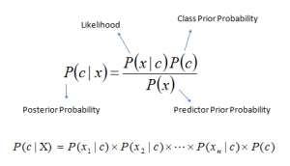
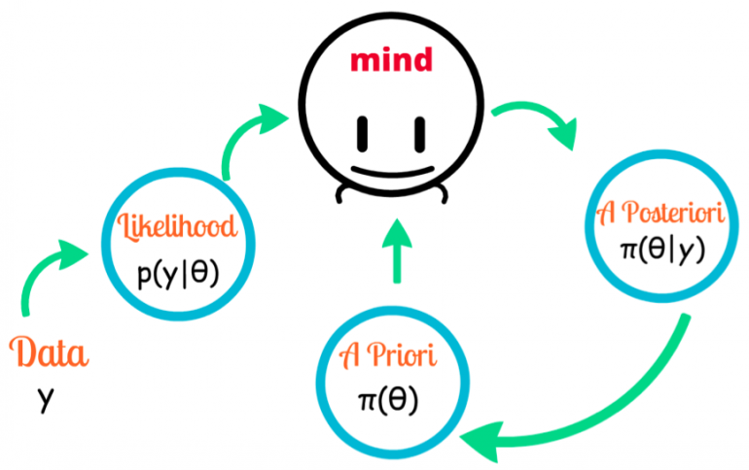
Un Supervised Learning
Above,
P(c|x) is the posterior probability of class (c, target) given predictor (x, attributes).
P(c) is the prior probability of class.
P(x|c) is the likelihood which is the probability of predictor given class.
P(x) is the prior probability of predictor.

Slide 8
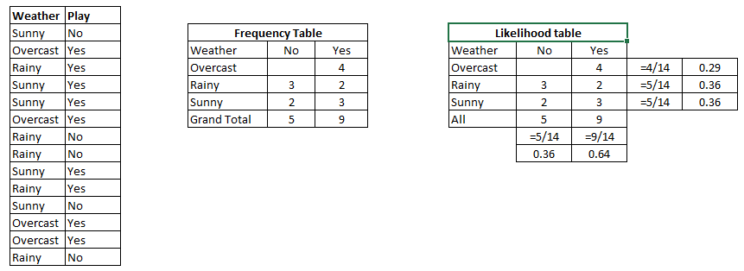
K Nearest Neighbors - Clustering
Problem: Players will play if weather is sunny. Is this statement is correct?
We can solve it using above discussed method of posterior probability.
P(Yes | Sunny) = P( Sunny | Yes) * P(Yes) / P (Sunny)
Here we have P (Sunny |Yes) = 3/9 = 0.33, P(Sunny) = 5/14 = 0.36, P( Yes)= 9/14 = 0.64
Now, P (Yes | Sunny) = 0.33 * 0.64 / 0.36 = 0.60, which has higher probability.
Notes:
https://www.analyticsvidhya.com/blog/2015/09/naive-bayes-explained/
http://blog.hackerearth.com/introduction-naive-bayes-algorithm-codes-python-r
http://radimrehurek.com/data_science_python/

Slide 9
KNN Demo + HandsOn

Slide 10


Slide 11
Thank you
Contact information:
Sundeep Gullapudi
Developer/ Pentester
Ph: 8977061710

